Slide 1
Factors Related To Industry
Men are more likely to be in relatively high-paying jobs, dangerous industries such as mining, construction while, women, are more likely to be in clerical jobs, working in service industry
Image taken from: https://www.ilo.org/wcmsp5/groups/public/---dgreports/---dcomm/---publ/documents/publication/wcms_650553.pdf
Most of the women do jobs which has flexible working hours.
According to some people when women negotiates their salaries the company doesn’t like to hire

Slide 2
International Scope of the Issue
There has been significant progress in Europe, UK, France, Germany on addressing gender pay gaps, with new legal requirements in force.
Even countries which may be traditionally more conservative in their approach have started introducing initiatives to ensure equal pay.
Image Taken from: https://www.ilo.org/wcmsp5/groups/public/---dgreports/---dcomm/---publ/documents/publication/wcms_650553.pdf
Image Taken from: https://www.ilo.org/wcmsp5/groups/public/---dgreports/---dcomm/---publ/documents/publication/wcms_650553.pdf

Slide 3
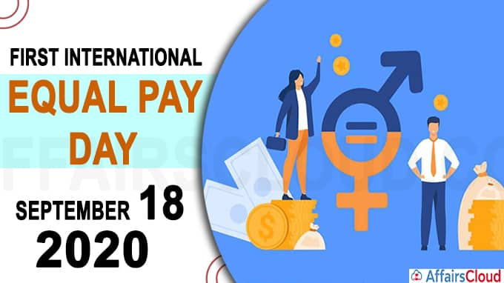
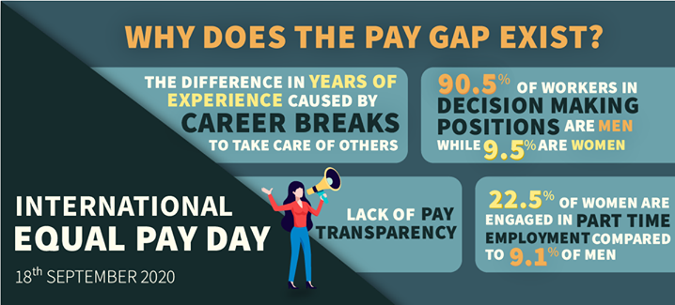
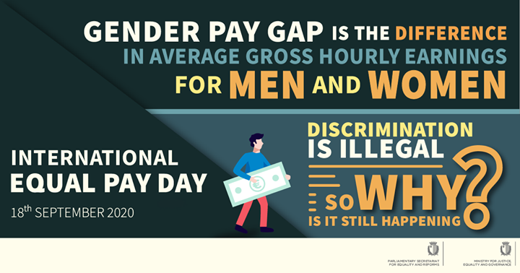
“Equal pay is essential not only for women but to build a world of dignity and justice for all.”
- António Guterres (Secretary-General of UN)
For the first time on 18th September 2020 International Equal Pay Day was celebrated for the longstanding efforts towards the achievement of equal pay for the equal work done
Image Taken from: https://affairscloud.com/1st-international-equal-pay-day-2020-18-september/
Image taken from: https://www.govserv.org/MT/Paola/135283117104230/Human-Rights-Directorate
The International Equal Pay Day builds on the United Nations commitment to human rights and against all forms of discrimination.
Worldwide, women make only 77 cents for every dollar earned by men, creating a lifetime of income inequality between men and women.

Slide 4
Social Pressure
Men has more opportunities than women
Women aren’t competitive
They won’t be able to handle both responsibilities
Women are better suited for home
Society believe/people say

